Slide 1

Art Theater Data Analysis
Jiyang Xu

Slide 2
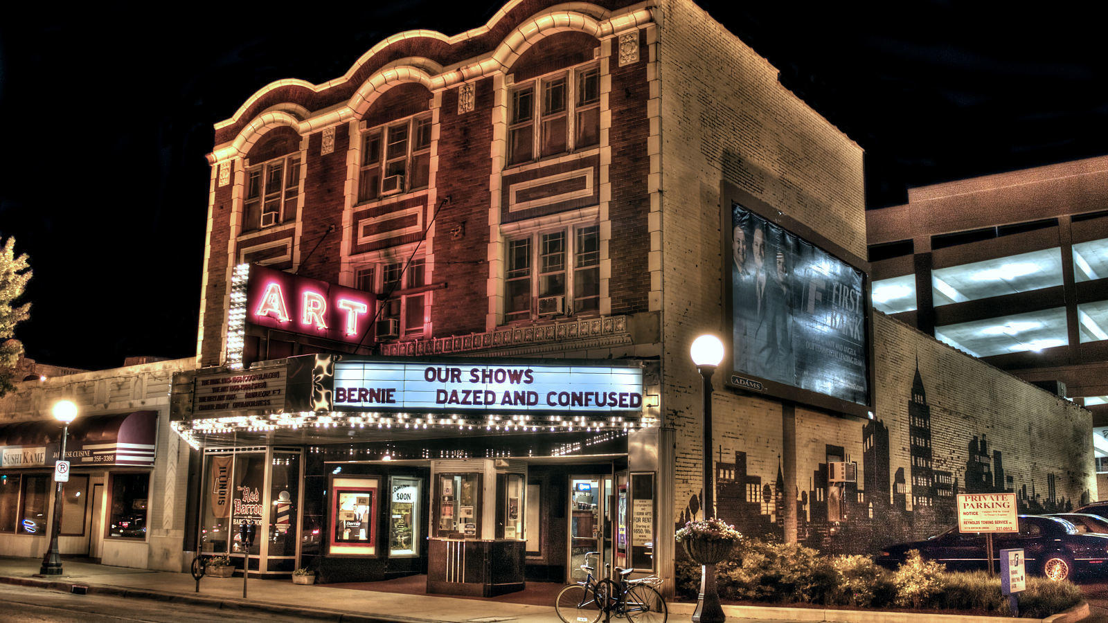
background information on the art theater
The Art Theater is located in the heart of Downtown Champaign since 1913. The Art Theater screens independent films and serves up locally grown popcorn, baked products from local bakeries and a great selection of wines, beers, soda and more.

Slide 3
Main Goal & Question
Main question: How does sales of tickets change as the categories of event and ticket types change?
Main goal: Finding the most targeting group from four major consumer types(students, adults, members, senior citizens) for different events in August 2019.

Slide 4
Data Processing
Choosing the data sets: "ticket_sales_by_showing.txt" and "gross_revenue_by_event.txt"
Using “EventName”, “TicketType”, “Quantity” in "ticket_sales_by_showing.txt"
Filtering out the data of ticket type students, adults, members, senior citizens
Filtering out data represents the events that have relatively complete records (#data total >= 15) in August 2019
Factors: four levels of consumer groups and five levels of events Response: quantity

Slide 5
background information on the events
Echo In The Canyon:
A look at the roots of the historic music scene in L.A.'s Laurel Canyon featuring the music of iconic groups such as The Beach Boys, Buffalo Springfield.
Maiden
The story of Tracy Edwards, a 24-year-old cook on charter boats, who became the skipper of the first ever all-female crew to enter the Whitbread Round the World Race in 1989.
Ophelia
A reimagining of Hamlet, told from Ophelia's perspective.
Pavarotti
Pavarotti is a documentary film about Italian operatic tenor Luciano Pavarotti
The Farewell
A Chinese family discovers their grandmother has only a short while left to live and decide to keep her in the dark, scheduling a wedding to gather before she dies.

Slide 6
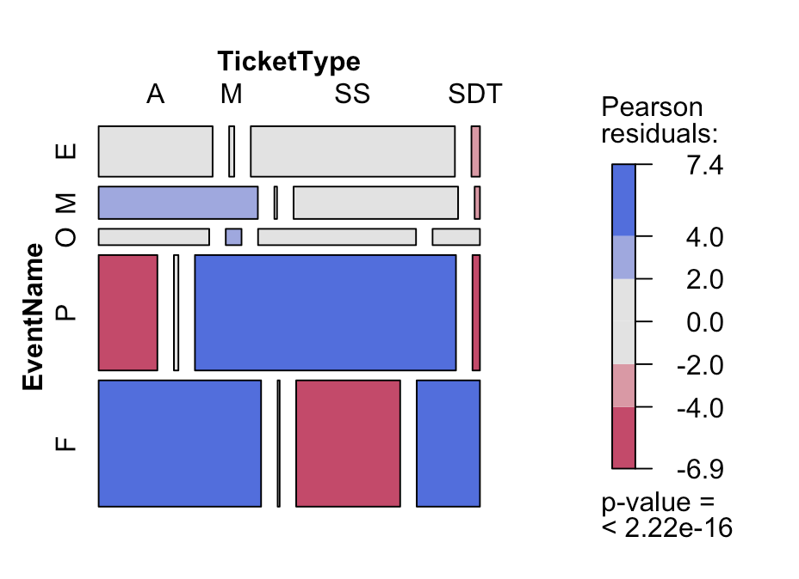
mosaic plot & some assumptions
senior citizen group in "Echo In The Canyon"
senior citizen group in "Pavarotti"
"The Farewell" in adult and member groups

Slide 7
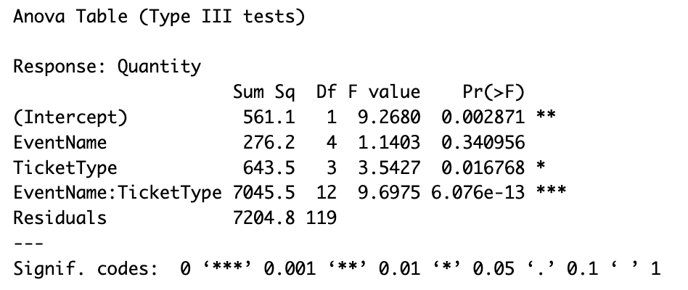
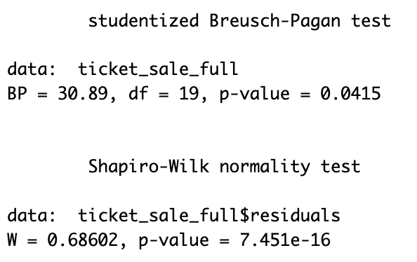
Selected model & Check Model Assumption

Slide 8
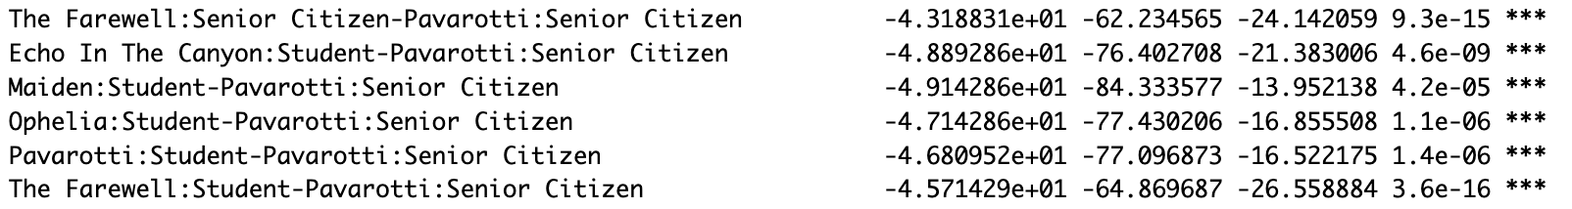
Pairwise Comparisons
Contradicts to assumption
the highest quantity is event "Pavarotti" with ticket type of "Senior Citizen", the second highest is event Maiden of ticket type "Member" while the lowest quantity is event "The Farewell" with ticket type "Student".

Slide 9
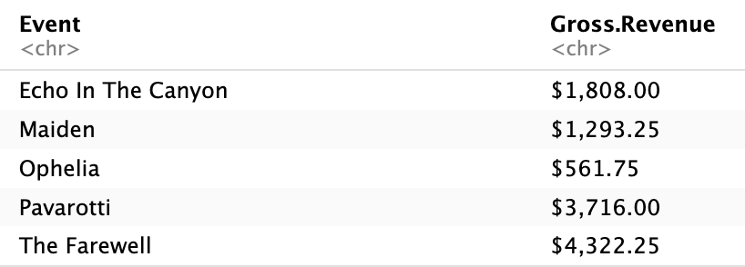
Results & Further Thinking
As a documentary film, Pavarotti is more attractive to senior citizens, and The Farewell is more popular to different age groups as a drama film.
In addition to finding target consumer groups, it is also very important to make products appeal to more people of different ages and have different backgrounds.

Slide 10


